Slide 1

Built hospitality dashboard to track revenue, bookings, occupancy, and cancellations
Created same KPI model in Excel, Power BI, and Tableau
Used MySQL for data querying and preparation
KPI consistency across Excel, Power BI, and Tableau
MySQL aggregation and data cleaning issues
Matching charts and metrics across tools
Tracks revenue, bookings, occupancy %, and cancellation rate
Includes city, hotel, room class, and weekly trend analysis
Added filters for dynamic dashboard interaction
Few cities/hotels drive most revenue
Revenue trend drops in later weeks
Luxury/Elite rooms generate higher value
Introduction
Overview
Challenges
Insights
Hospitality Analytics Project
By group - 6

Slide 2
Built hospitality dashboard to track revenue, bookings, occupancy, and cancellations
Created same KPI model in Excel, Power BI, and Tableau
Used MySQL for data querying and preparation
Tracks revenue, bookings, occupancy %, and cancellation rate
Includes city, hotel, room class, and weekly trend analysis
Added filters for dynamic dashboard interaction
KPI consistency across Excel, Power BI, and Tableau
MySQL aggregation and data cleaning issues
Matching charts and metrics across tools
Few cities/hotels drive most revenue
Revenue trend drops in later weeks
Luxury/Elite rooms generate higher value
Introduction
Overview
Challenges
Insights

Slide 3
Excel Hospitality Performance Dashboard

Slide 4
Excel Hospitality Performance Dashboard
Dashboard Features
Challenges
Dynamic Excel dashboard is built using interactive filters and visuals, allowing users to analyze performance by month and city.
It includes Weekday vs Weekend performance in terms of bookings and revenue.
Booking status distribution (checked-out, cancelled, no-show).
Revenue contribution by room class.
Weekly occupancy trends.
Revenue comparison across cities and hotels.
It also tracks weekly trends of revenue and bookings to understand demand patterns over time
Designing the dashboard layout to present multiple metrics clearly without clutter·
Ensuring Pivot Tables and charts update correctly with slicers and filters.

Slide 5
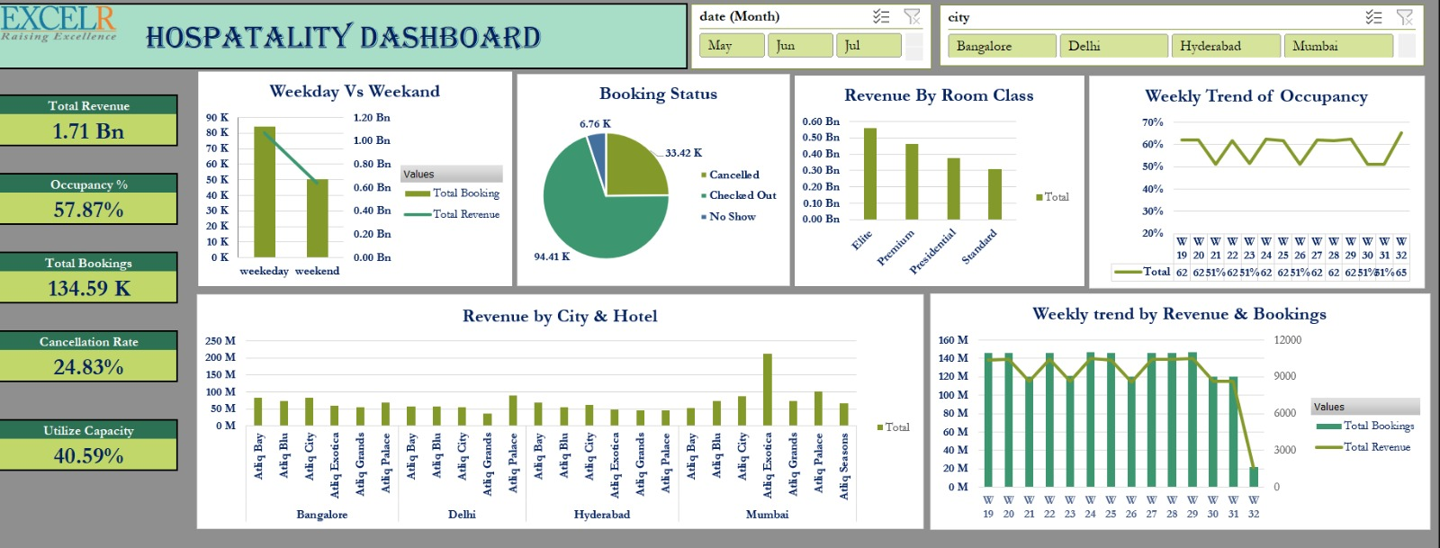
Excel Hospitality Performance Dashboard

Slide 6
KPI Overview
KPI cards present a quick summary of business performance including revenue, bookings, occupancy rate, capacity utilization, and cancellation percentage
Demand and Revenue
Trend
Weekly trend visuals help track changes in bookings and revenue, enabling identification of peak and low demand periods
Category & location Insights
Room class and city-level performance analysis highlight key revenue-generating segments and top-performing hotel locations.
Interactive Performance Analysis
Interactive slicers for month and city allow users to dynamically filter data and perform quick performance comparisons for better decision-making

Slide 7
KPI Overview
KPI cards present a quick summary of business performance including revenue, bookings, occupancy rate, capacity utilization, and cancellation percentage
Demand and Revenue
Trend
Weekly trend visuals help track changes in bookings and revenue, enabling identification of peak and low demand periods
Category & location Insights
Room class and city-level performance analysis highlight key revenue-generating segments and top-performing hotel locations.
Interactive Performance Analysis
Interactive slicers for month and city allow users to dynamically filter data and perform quick performance comparisons for better decision-making

Slide 8
Power BI Hospitality Performance Dashboard

Slide 9
Power BI Hospitality Performance Dashboard
Dashboard Features
Challenges
Tracks KPIs like Revenue, Bookings, Occupancy %, Cancellation %, and Booking Status with real-time metric cards.
Uses interactive filters for City, Hotel, Room Class, and Week to compare performance quickly.
Shows weekly revenue and booking trends to spot growth and seasonal patterns.
Supports drill-down from city to hotel to room category for detailed analysis.
Includes comparison visuals for room class, weekday vs weekend, and booking status distribution.
Standardizing and formatting booking, hotel, and room data for consistent reporting.
Building correct data model relationships across multiple tables.
Creating accurate DAX KPIs for Occupancy, Cancellation Rate, and Revenue splits.
Optimizing dashboard performance and selecting clear visuals without overcrowding.

Slide 10
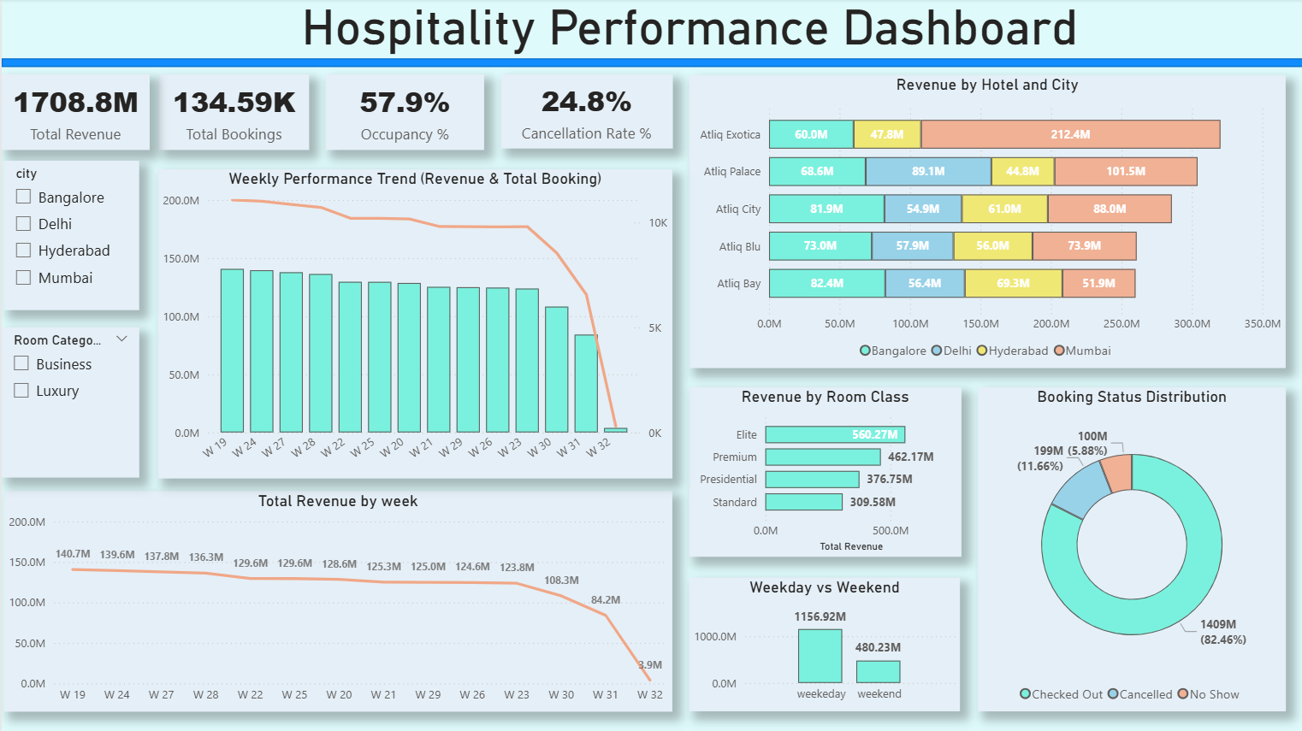
Power BI Hospitality Performance Dashboard

Slide 11
KPI Overview
KPI cards provide a quick snapshot of revenue, bookings, occupancy, and cancellation performance
Trend Analysis
Trend charts reveal weekly performance patterns and demand fluctuations
Segment Performance
City and room category visuals identify top revenue contributors
Interactive Analysis
Filters and drill-down enable fast, user-driven performance analysis

Slide 12
KPI Overview
KPI cards provide a quick snapshot of revenue, bookings, occupancy, and cancellation performance
Trend Analysis
Trend charts reveal weekly performance patterns and demand fluctuations
Segment Performance
City and room category visuals identify top revenue contributors
Interactive Analysis
Filters and drill-down enable fast, user-driven performance analysis

Slide 13
Tableau Hospitality Performance Dashboard

Slide 14
Tableau Hospitality Performance Dashboard
Dashboard Features
Challenges
KPI tiles showing Total Revenue, Occupancy %, Utilized Capacity, Total Bookings, and Cancellation Rate.
Class-wise revenue bar charts comparing Elite, Premium, Presidential, and Standard categories.
City and hotel-wise revenue visuals for location performance comparison.
Booking status breakdown showing Checked-out, Cancelled, and No-show distribution.
Time-based analysis with daily revenue trend and weekly revenue vs booking charts.
Weekday vs Weekend revenue and booking comparison view.
Interactive filter panels for Room Class, Category, and City selection.
Creating calculated fields for occupancy, utilization, and status metrics instead of predefined measures.
Managing dimensions and measures correctly while building multiple worksheets.
Applying and syncing filter cards across all dashboard sheets.
Combining multiple visual sheets into one clean, aligned dashboard layout.
Maintaining consistent scales, colors, and labels across different charts.

Slide 15
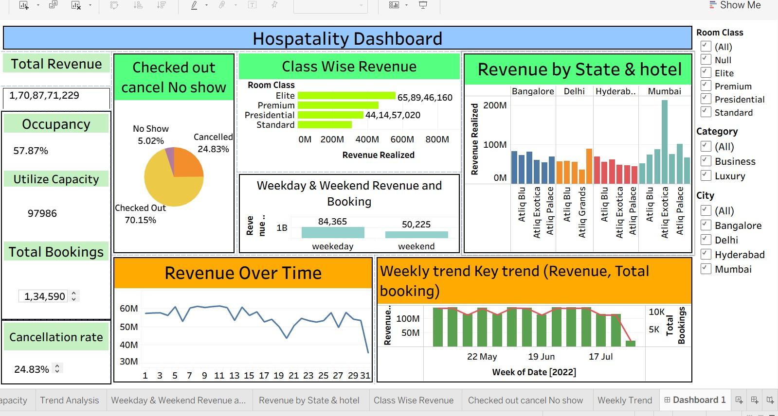
Tableau Hospitality Performance Dashboard

Slide 16
Core Metrics View
Shows key dashboard indicators including total revenue, occupancy rate, bookings, and cancellation percentage for quick status review
Time Pattern Analysis
Visualizes revenue over time and weekly booking trends to identify fluctuations and period-wise performance changes
Category & Location Insights
Compares room class and city/hotel revenue to highlight top contributors and segment performance differences
Filter-Driven Exploration
Interactive filter cards allow users to slice results by room class, category, and city for flexible analysis

Slide 17
Core Metrics View
Shows key dashboard indicators including total revenue, occupancy rate, bookings, and cancellation percentage for quick status review
Time Pattern Analysis
Visualizes revenue over time and weekly booking trends to identify fluctuations and period-wise performance changes
Category & Location Insights
Compares room class and city/hotel revenue to highlight top contributors and segment performance differences
Filter-Driven Exploration
Interactive filter cards allow users to slice results by room class, category, and city for flexible analysis

Slide 18
MySQL Hospitality Performance Analysis

Slide 19
MySQL Hospitality Performance Analysis
SQL Analysis Features
Challenges
Structured hospitality data stored and managed using relational tables.
SQL queries used to calculate revenue, bookings, occupancy, and cancellation metrics.
JOIN operations applied across booking, hotel, and room tables for combined analysis.
GROUP BY and aggregation functions used for city, class, and time-based summaries.
Filtered queries built to compare weekday vs weekend and category performance.
Derived metrics created using calculated query expressions.
Loading large datasets into MySQL tables took higher processing and import time.
Initial data load and indexing were slower due to large dataset size.
Optimizing query performance for large datasets.
Handling date fields for weekly and monthly trend queries.
Bulk data upload took longer because of table size and record volume.

Slide 20
Thank you

